Slide 1
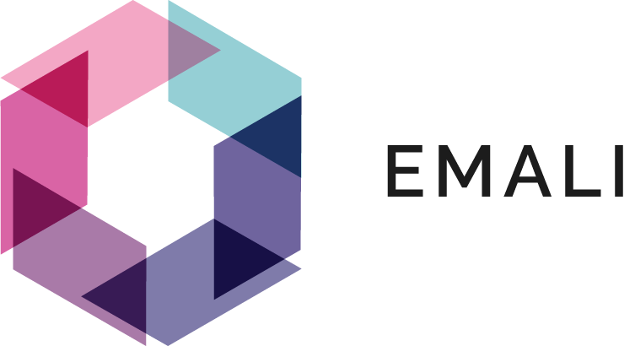
What is Blockchain Technology

Slide 2
Introduction
In today's digital era, data security, transparency, and efficiency are paramount. Blockchain technology offers a robust solution to address these challenges.
Blockchain is a decentralized, transparent, and immutable digital ledger that enables secure and tamper-proof transactions and data storage.

Slide 3
Key Concepts of Blockchain
Blocks:
In blockchain, data is organized into blocks, which are containers that hold a collection of transactions or other relevant information.
Each block contains a unique identifier called a hash, which is generated using cryptographic hashing algorithms.
Blocks are linked together in a chronological order, forming a chain of blocks, hence the term "blockchain.“
Transactions:
Transactions represent the exchange of value or information within a blockchain network.
Transactions contain important data, such as the sender, recipient, amount, and any additional information relevant to the specific use case.
Each transaction is validated, verified, and recorded on the blockchain, ensuring the integrity and transparency of the network.
.
Cryptographic Hashing:
Cryptographic hash functions play a crucial role in blockchain technology.
Consensus Mechanisms::
Consensus mechanisms enable agreement among participants on the validity of transactions and the order in which they are added to the blockchain.
Hash functions convert any input data into a fixed-size output, known as a hash.
Hashes are unique and irreversible, meaning it is extremely difficult to derive the original data from a given hash.
Hashes provide integrity and security, as even a small change in the input data will produce a significantly different hash.
Common consensus mechanisms include Proof of Work (PoW), Proof of Stake (PoS), and Practical Byzantine Fault Tolerance (PBFT).
PoW requires participants to solve complex mathematical puzzles to validate transactions, while PoS relies on participants' ownership stake in the network.
Consensus mechanisms ensure that all participants in the blockchain network reach a shared state of agreement without relying on a central authority

Slide 4
Benefits of Blockchain
Enhanced Security:
Blockchain employs advanced cryptographic techniques to secure transactions and data.
Efficiency:
Smart contracts, self-executing agreements coded on the blockchain, enable automated and transparent execution of business processes, reducing paperwork and delays.
Cost Reduction:
Blockchain enables peer-to-peer transactions, eliminating the need for traditional intermediaries such as banks or clearinghouses
Transparency:
Participants in the network can view and verify the entire transaction history, ensuring accountability and trust among all parties involved.
Immutability:
The use of cryptographic hash functions and consensus mechanisms ensures that previously recorded information cannot be altered or tampered with.
.

Slide 5
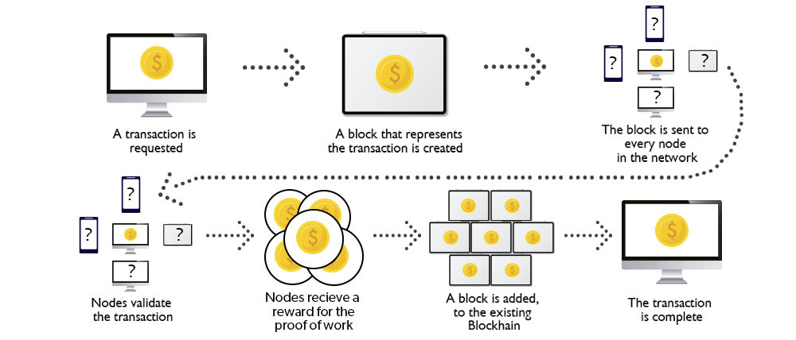
How does works

Slide 6
Blockchain platform
Ethereum
Ethereum is one of the most popular open-source blockchain platforms.
Hyperledger Fabric
Hyperledger Fabric is an open-source blockchain framework hosted by the Linux Foundation
Corda
Corda is an open-source blockchain platform specifically designed for enterprise use cases.
EOSIO
EOSIO is an open-source blockchain platform known for its high performance and scalability.
Quorum
Quorum is an open-source blockchain platform developed by J.P. Morgan. It is based on Ethereum but tailored for private enterprise use cases, offering enhanced privacy and permissioning features
Stellar
Stellar is an open-source blockchain platform designed for fast and low-cost cross-border transactions
Tezos
Tezos is an open-source blockchain platform that emphasizes self-amendment and on-chain governance.
Aeternity
Aeternity is an open-source blockchain platform that combines the features of blockchain and off-chain computation.
NEM
NEM (New Economy Movement) is an open-source blockchain platform that provides a customizable and modular infrastructure for building blockchain applications.
Algorand
Algorand is an open-source blockchain platform focused on scalability and security.
blockchain-based platform that enables end-to-end transparency in the food supply chain.

Slide 7
THANK YOU!

